Slide 1

Networking, ThingSpeak and Temperature Sensors

Slide 2
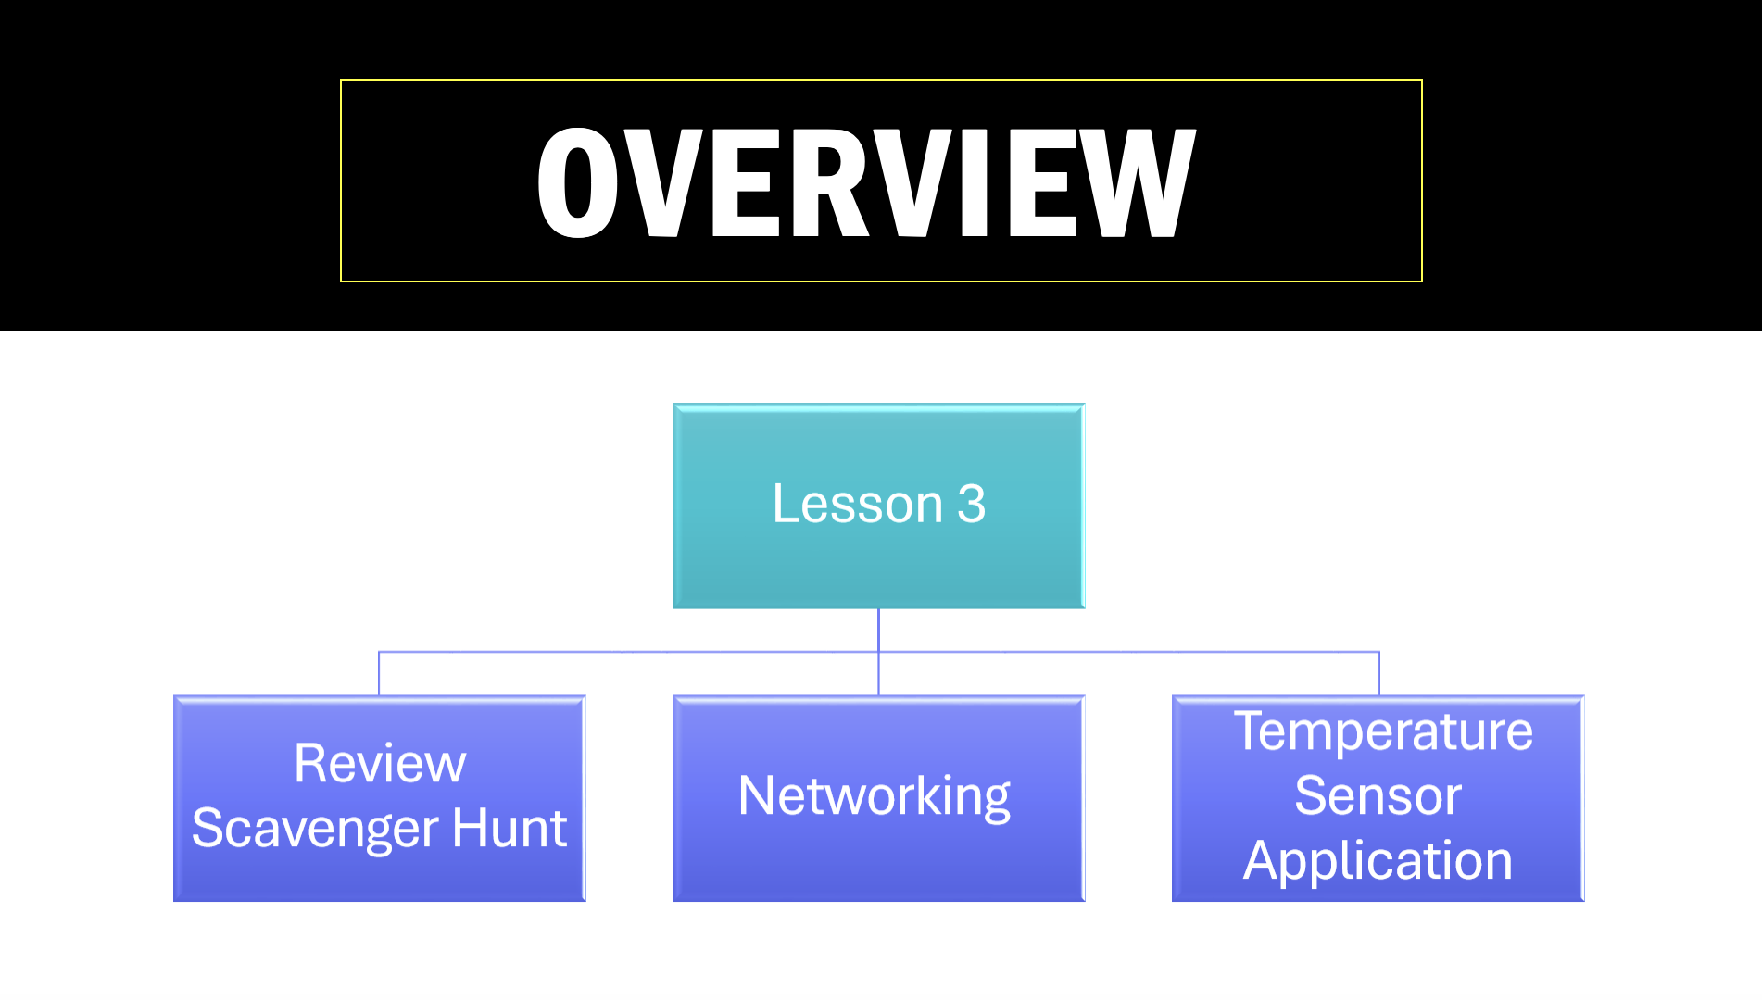

Slide 3

Look Around the Room There are posters displayed all around the room. Each poster has two parts:
Top section: An answer
Bottom section: A question
Start with Any Poster (no more than 2 students per poster)
Read the question at the bottom of the poster and record the number.
Find the Matching Answer
Search the room for the poster that has the correct answer to that question at the top and record the answer.
Continue the Chain
Once you find the matching answer, read the new question at the bottom of that poster. Repeat the process—look for the next correct answer.
Track Your Progress
Use the scavenger hunt sheet provided to record each step (question and matching answer).
Finish the Hunt
The scavenger hunt ends when 10 minutes have passed. (Hint: You should return to the starting question or complete the full loop.)
Scavenger Hunt Review Game
I

Slide 4
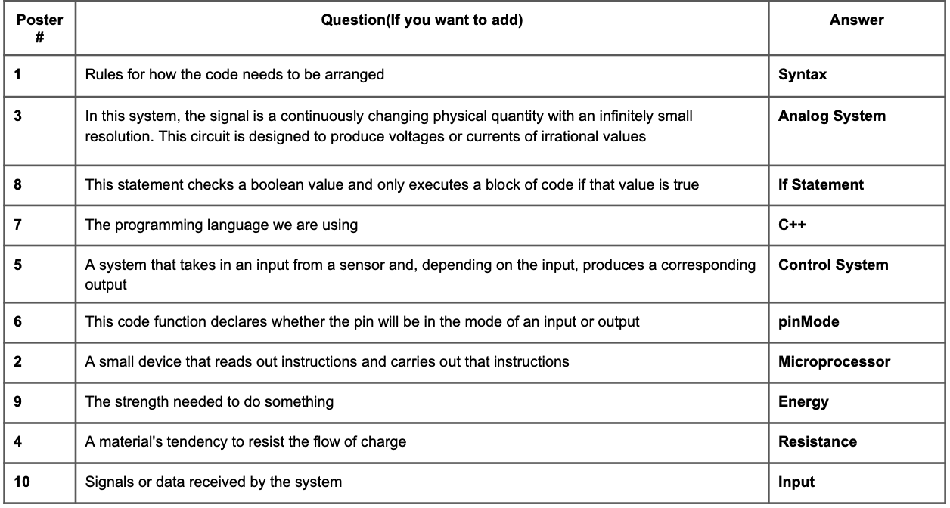
Check Yourself

Slide 6

NETWORKING VIDEO

Slide 7
Lesson 3 Coding Lesson

Slide 8
PART 1
SERIAL MONITOR
DHT11 Temperature Sensor

Slide 9
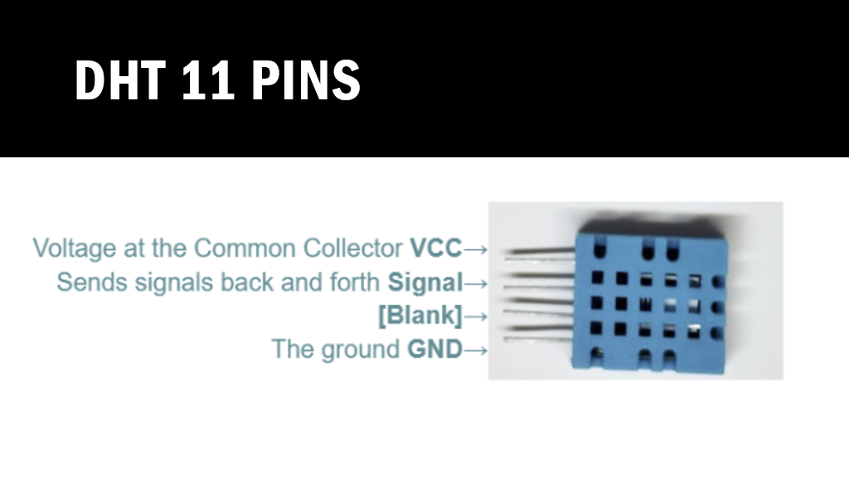

Slide 10
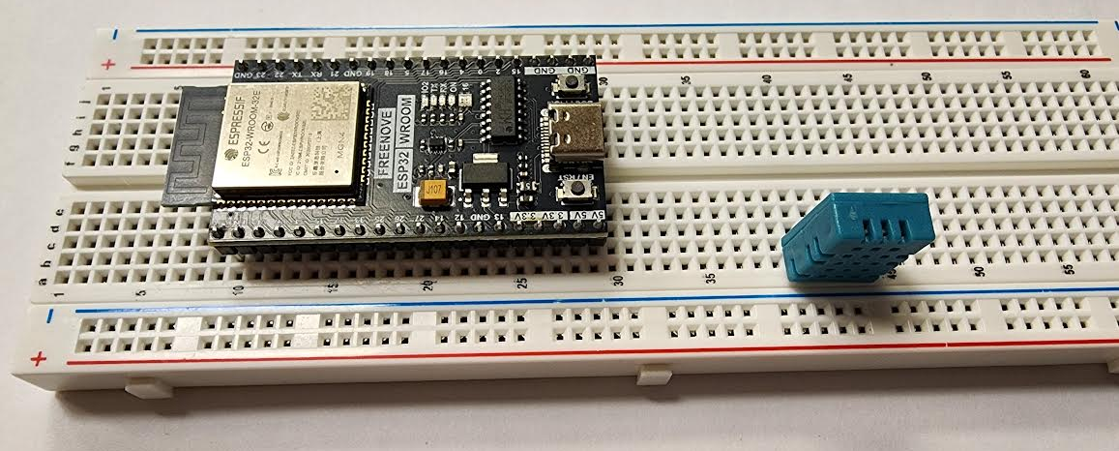
On your breadboard, place the ESP32 with the side on your left on
b 10 - b 29
And the temperature sensor
with the VCC pin on b 40
and GND pin b 43

Slide 11
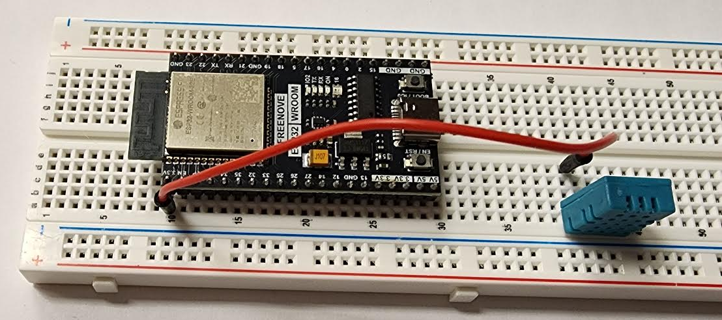
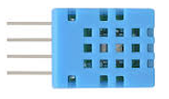
Connect the
VCC pin of the sensor
b 40
to the ESP32 3.3V pin
a 10
By placing a wire from
a 10
to
e 40

Slide 12
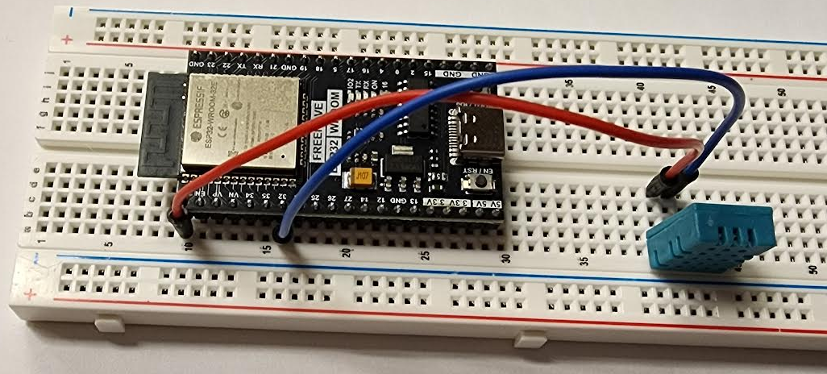
Connect the
Signal pin of the sensor
a 41
to the ESP32 GPIO 32
b16
By placing a wire from
e 41
to
a 16

Slide 13
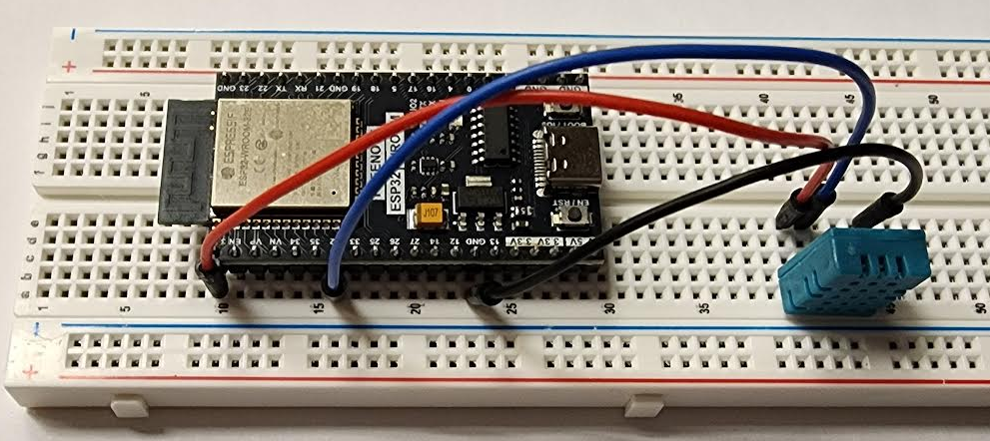
Finally, GND pin of the sensor
a 43
to the GND pin ESP32
b 23
By placing a wire from
e 43
to
a 23

Slide 14
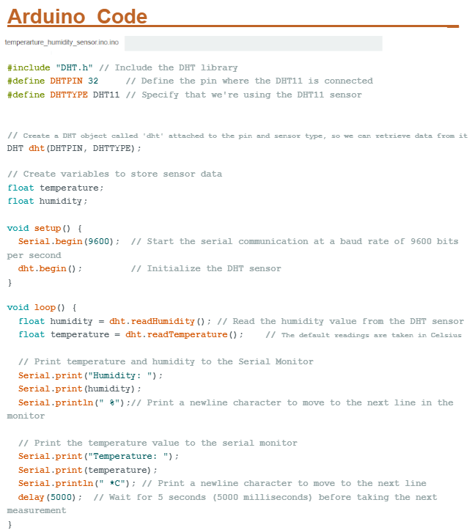

Slide 15
DHT
dht
(DHTPIN, DHTTYPE)
;
This now means the following code:
Working with a dht sensor
In this location
And this type
.
Pin 32
DHT 11

Slide 16
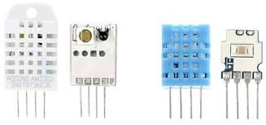
Digital Humidity and Temperature (DHT)

Slide 18
.begin

Slide 21
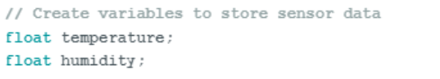

Slide 22
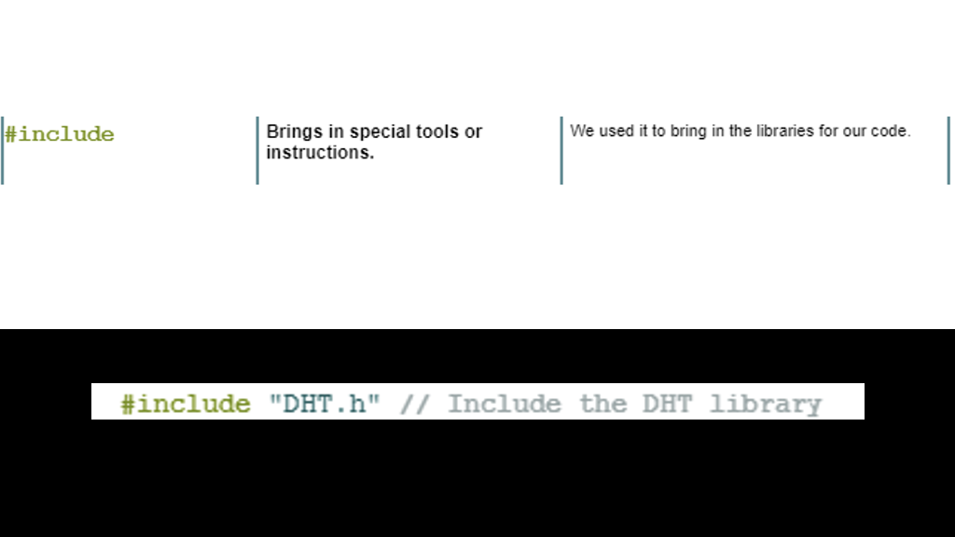

Slide 23
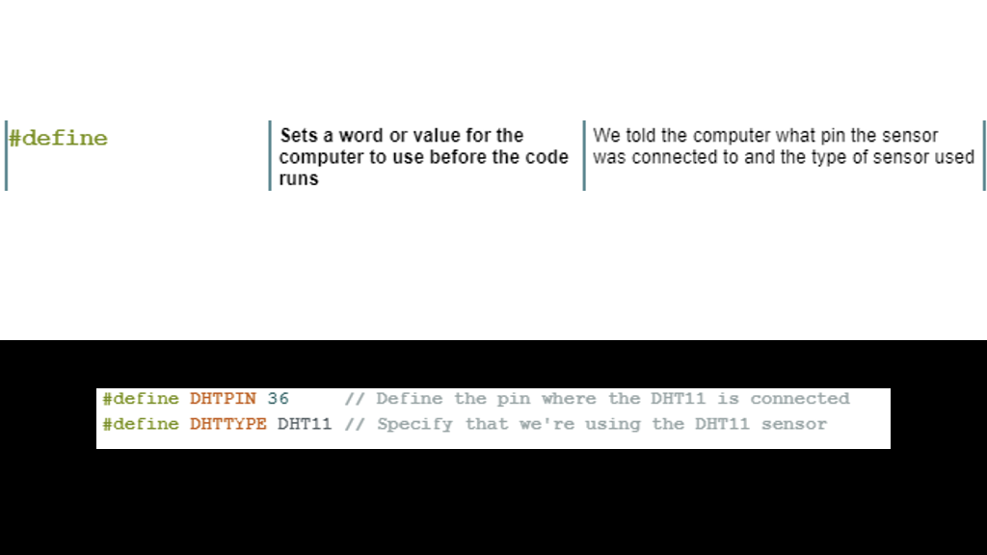

Slide 24
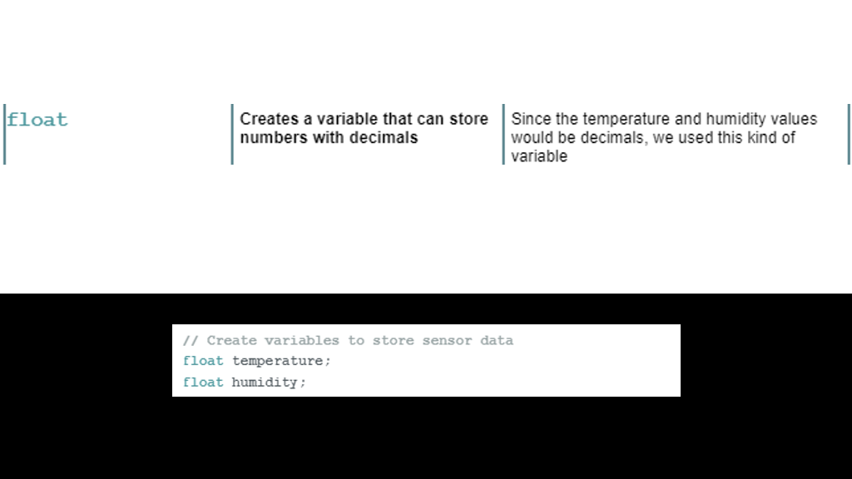

Slide 25
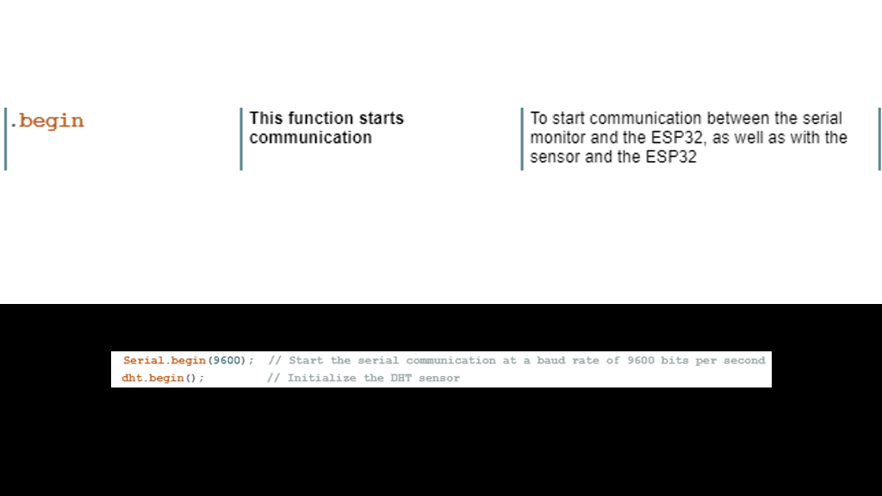

Slide 26
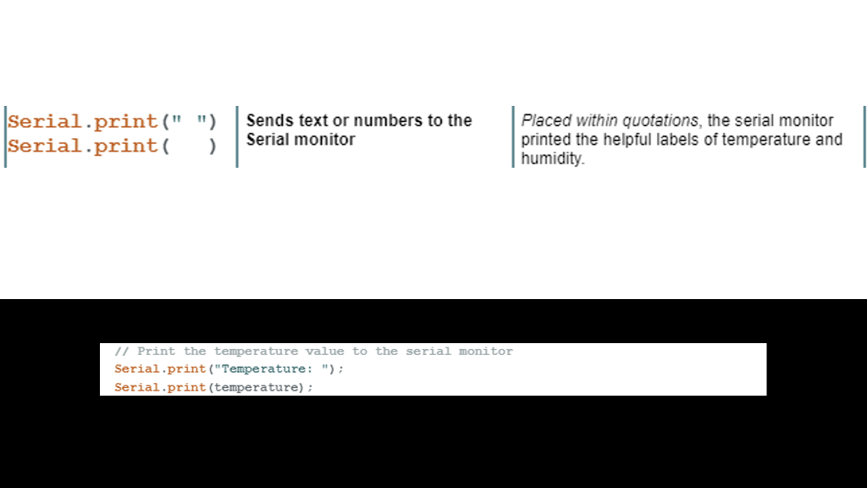

Slide 27
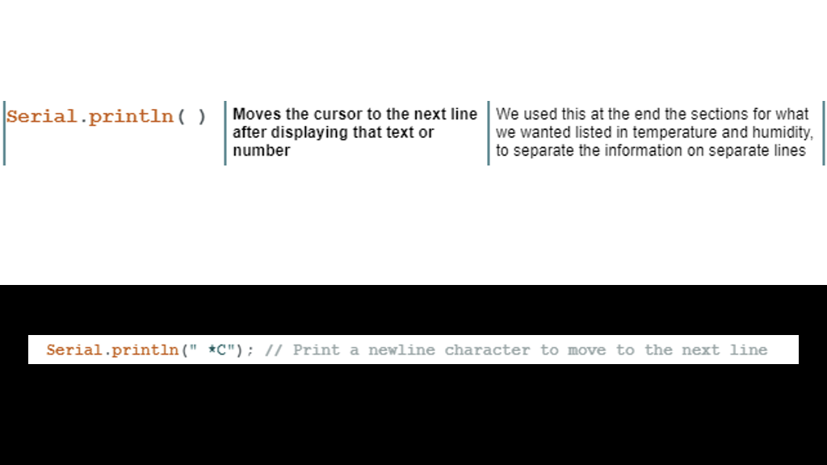

Slide 28
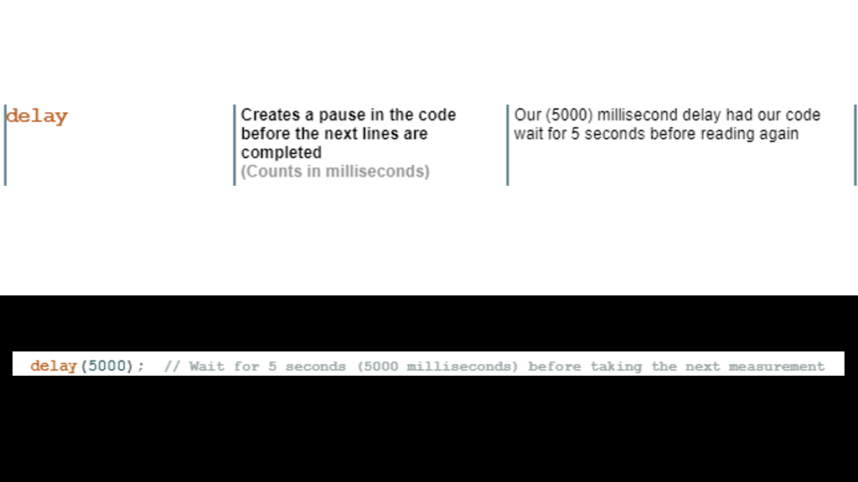

Slide 29
PART 2
THINGSPEAK
DHT11 Temperature Sensor

Slide 30


Slide 31
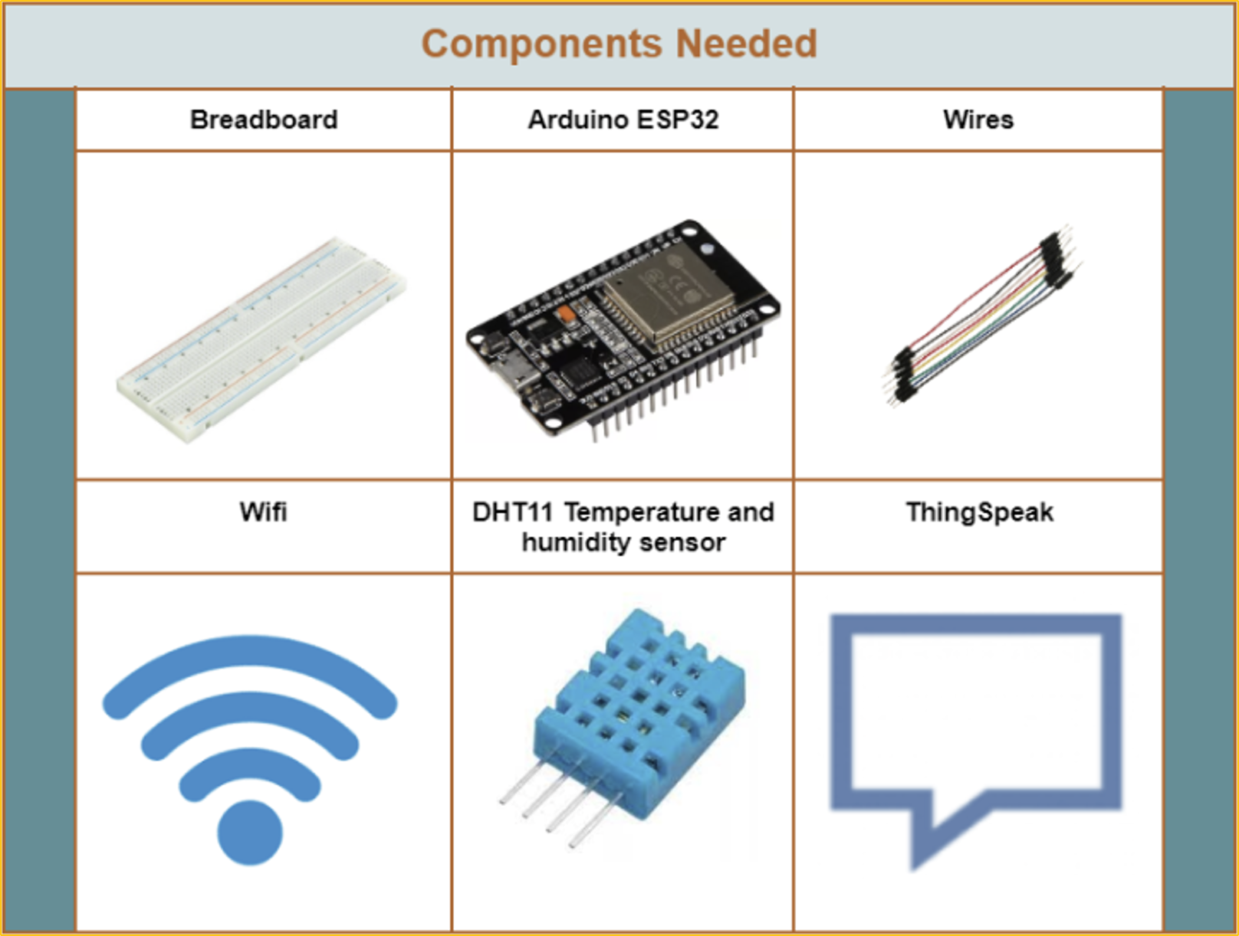

Slide 32
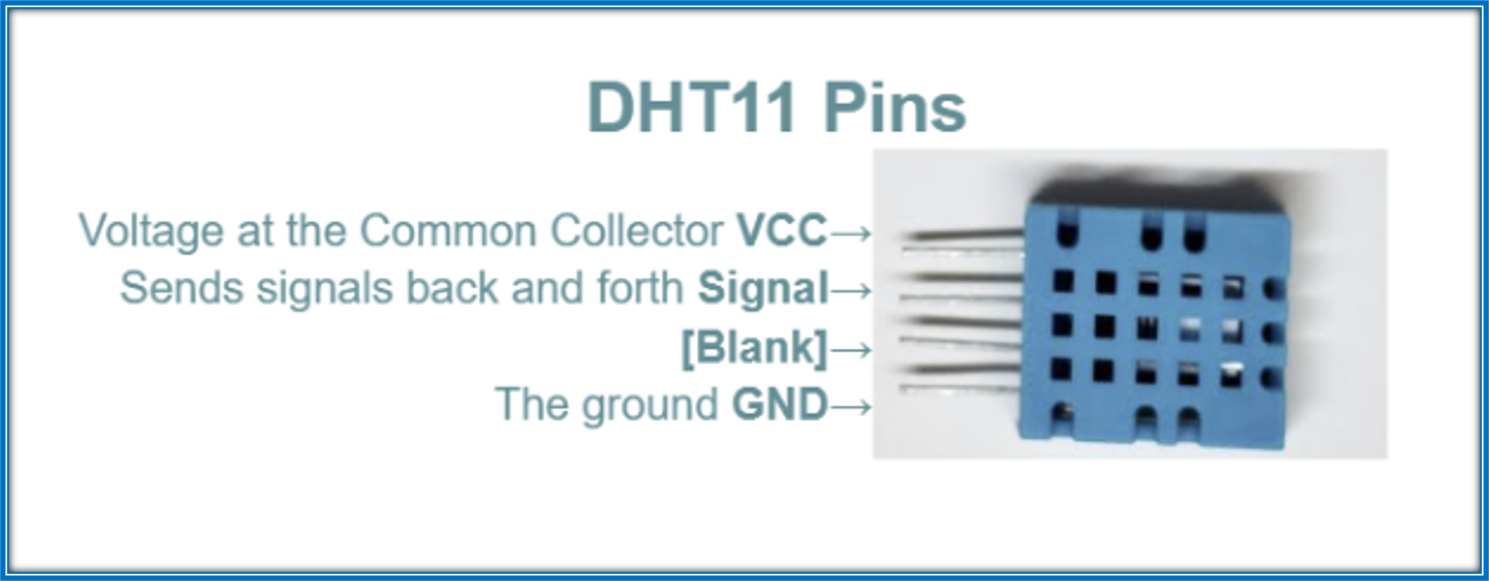

Slide 33
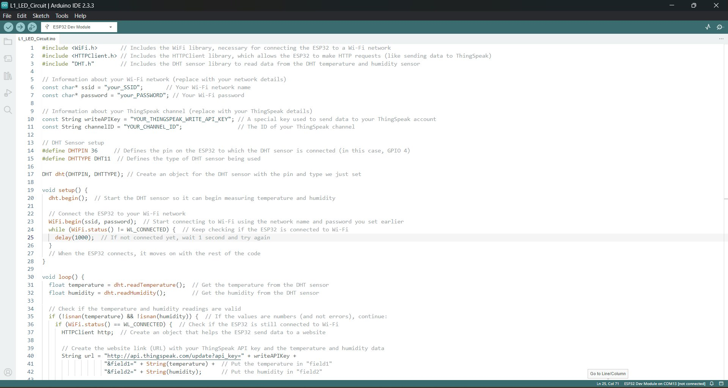
Notes:
Then enter the pin number into the correct place within the code

Slide 35
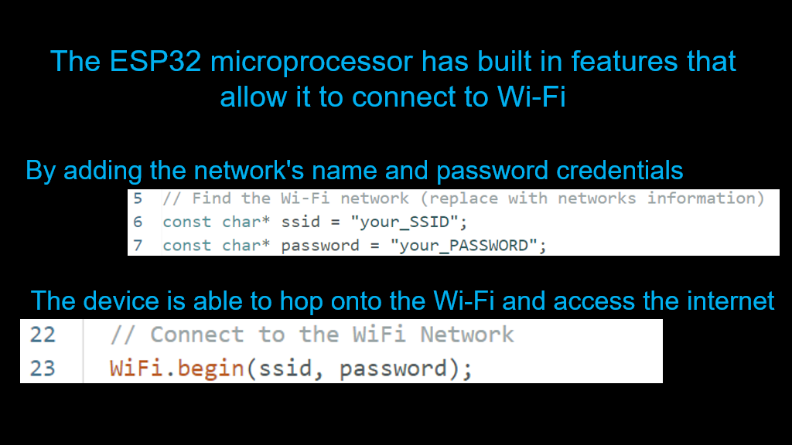

Slide 36
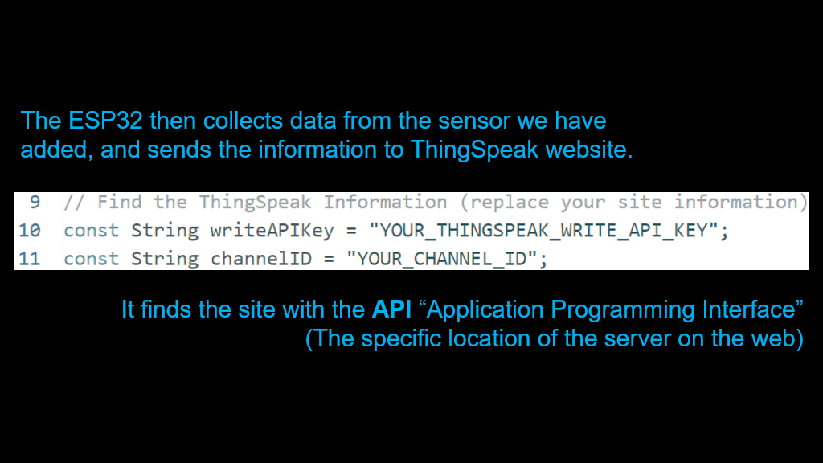
Z

Slide 37
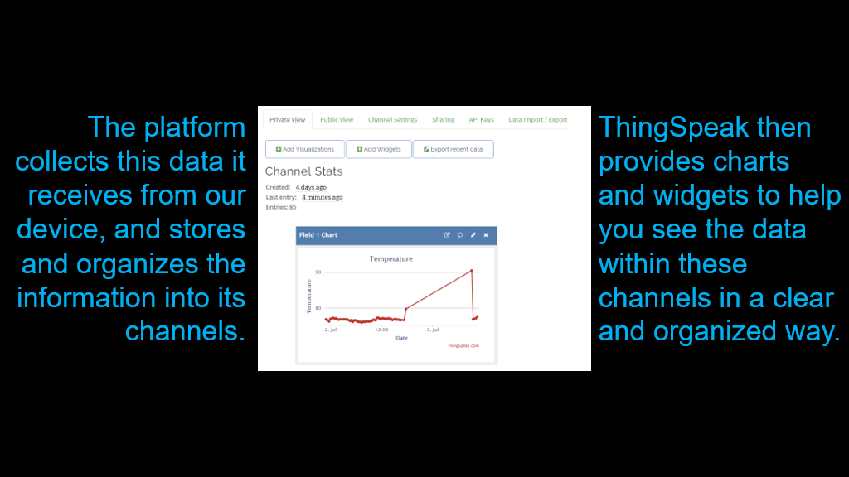

Slide 38
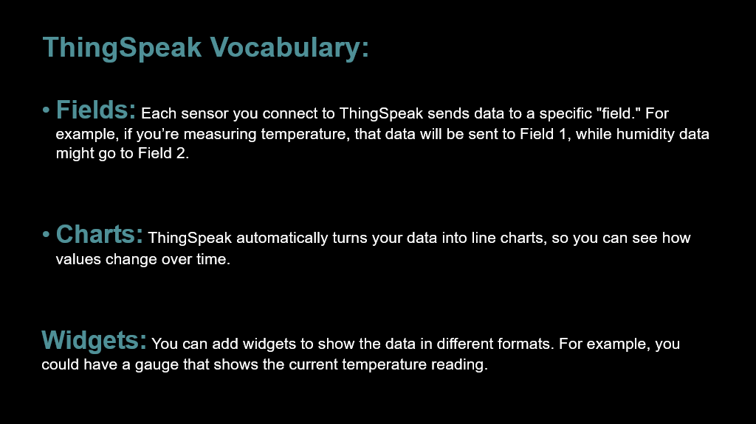

Slide 39
LESSON ACTIVITY

